Slide 1
PIUS XI CAMPUS MINISTRY

Slide 2
Followers of francis
Campus Ministry is about how YOU want to grow closer to God and how YOU will go out and change the world

Slide 3
Taking time away

Slide 4
retreats

Slide 5
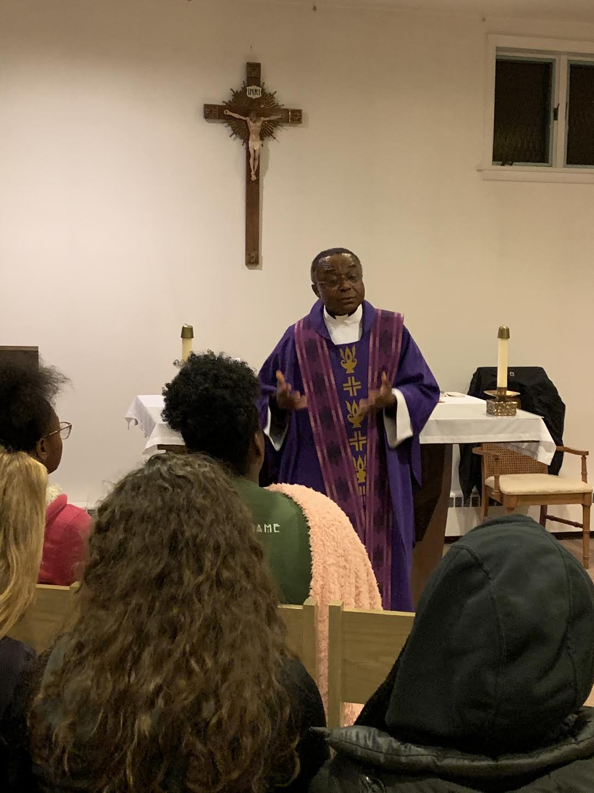
prayer

Slide 6
How can I be more ….. Me?

Slide 7
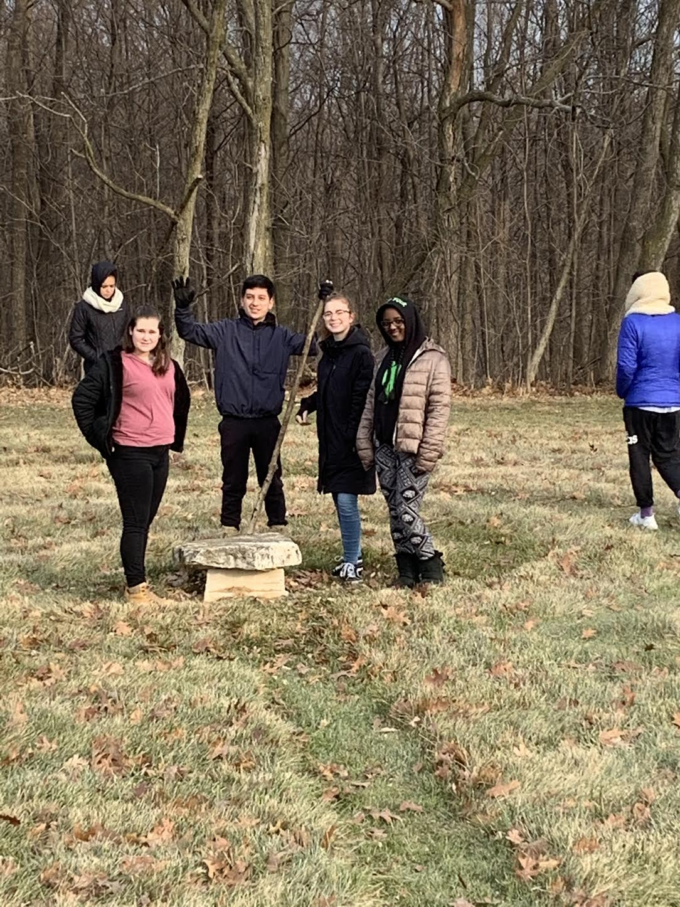
We journey together!

Slide 8
Unity!

Slide 9
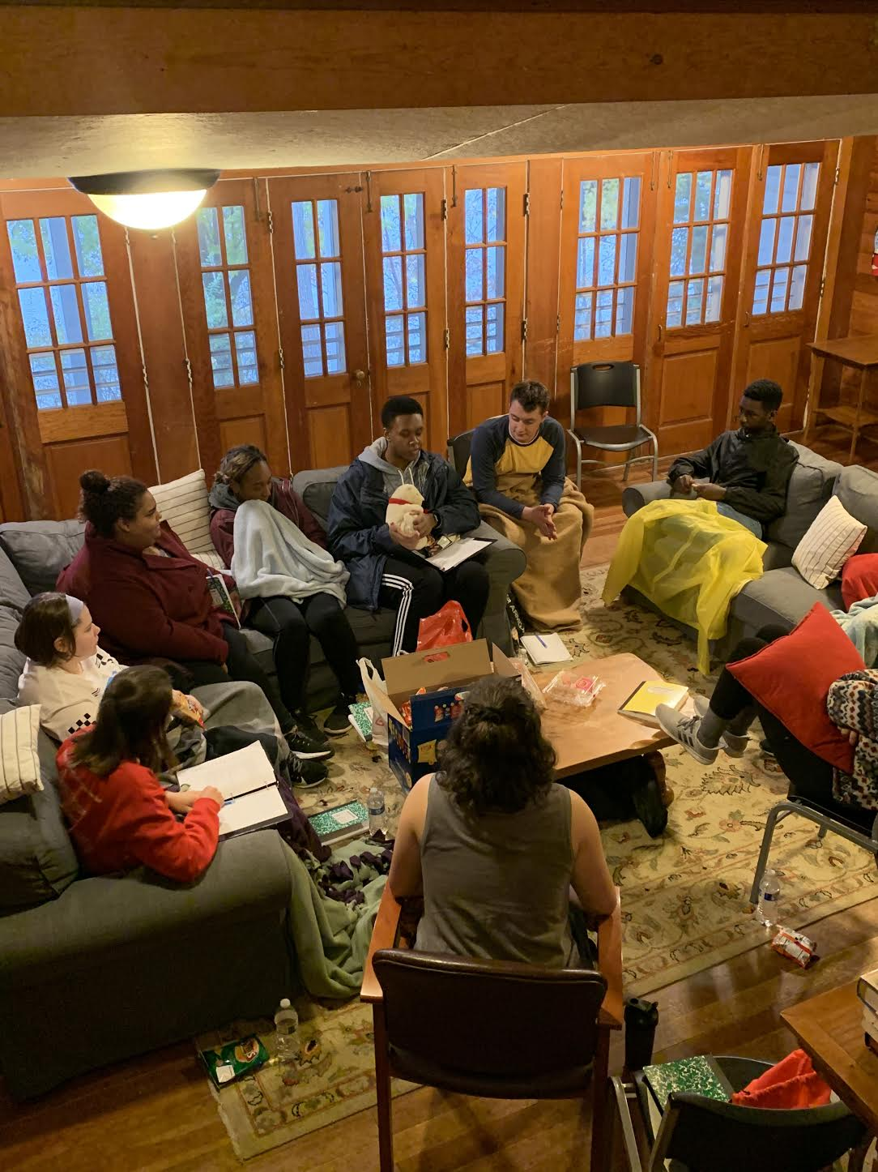
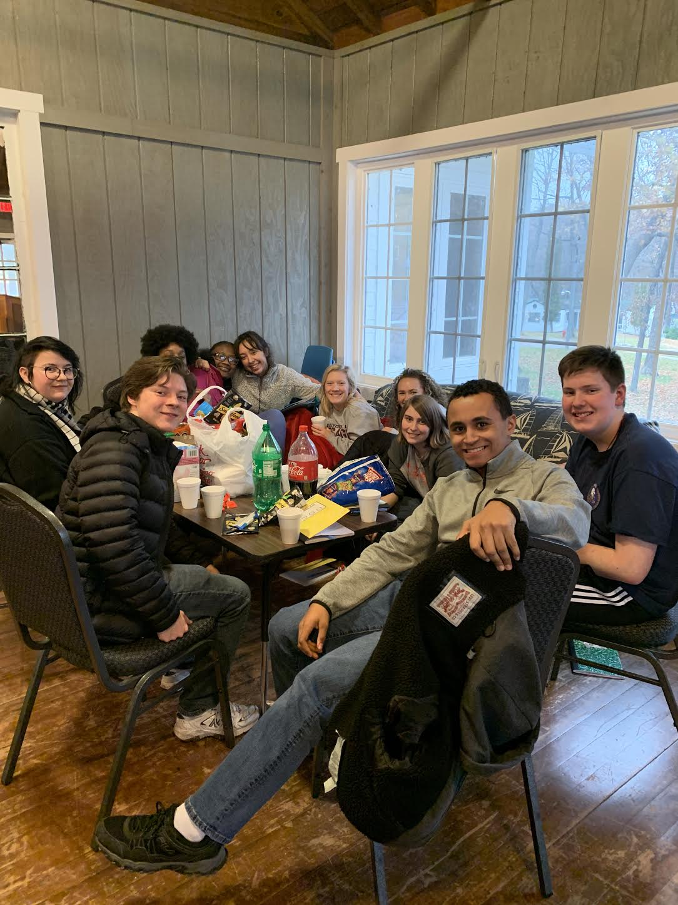
We are one body!

Slide 10
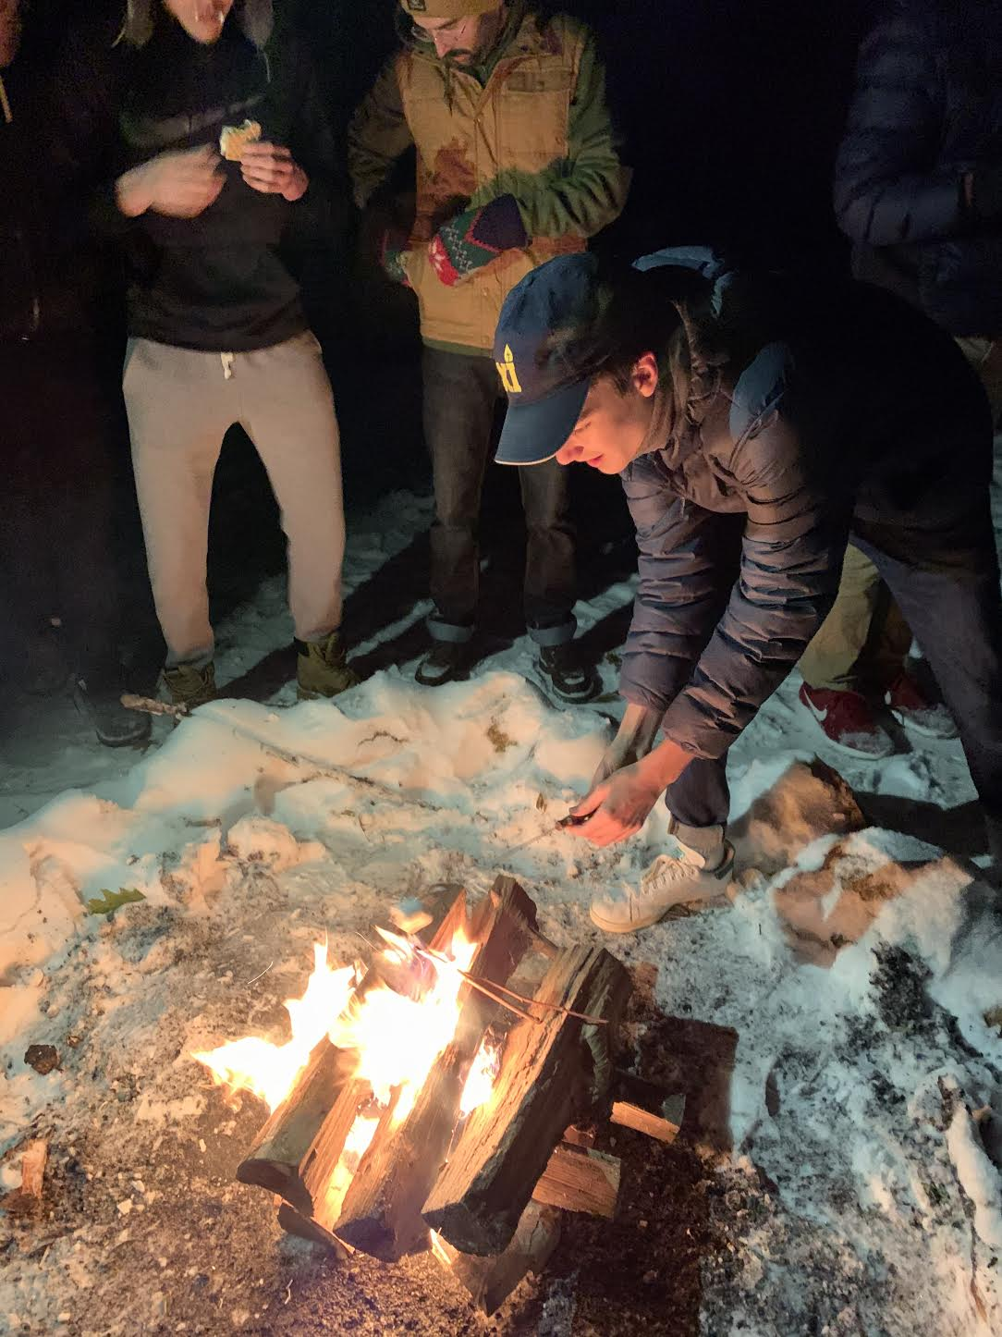
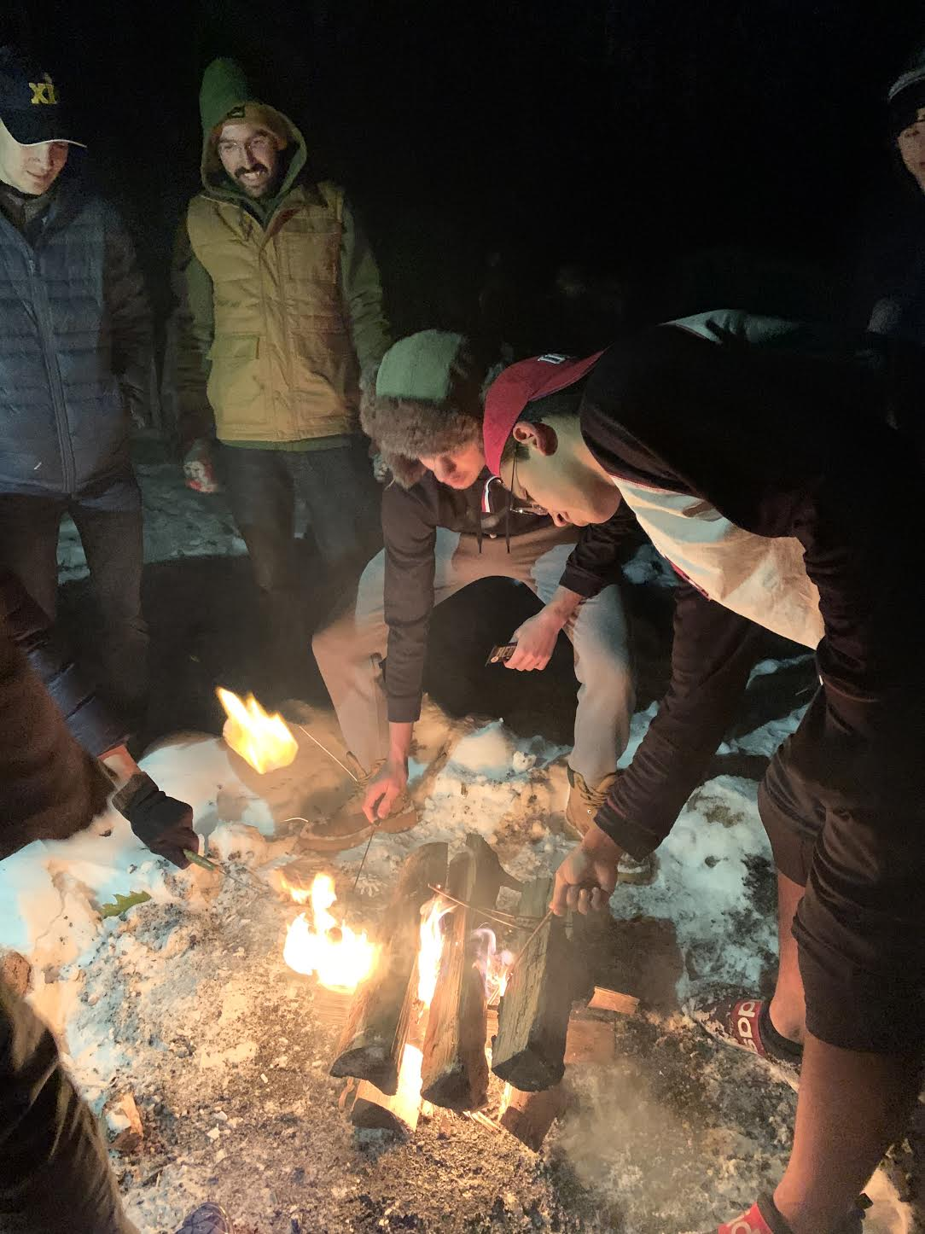
Making friends

Slide 11
together

Slide 12
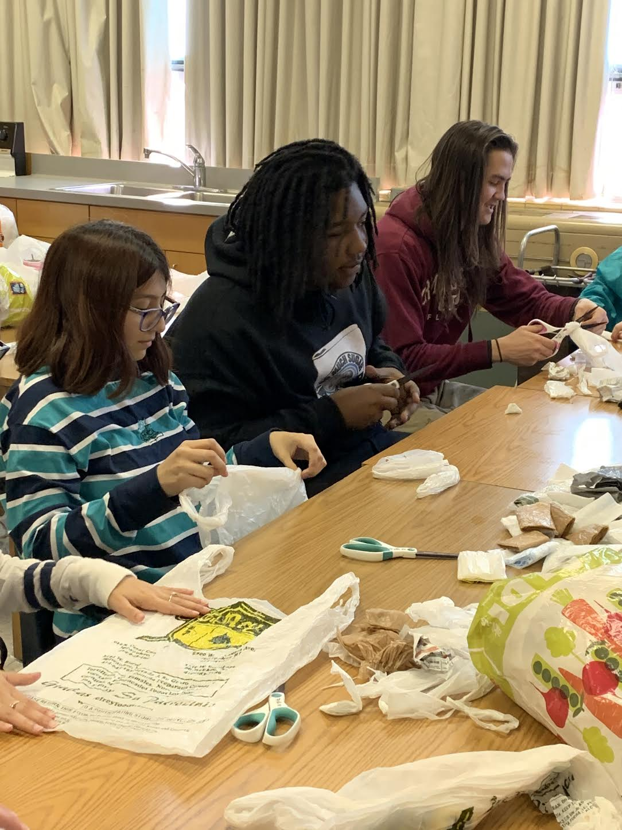
service

Slide 13
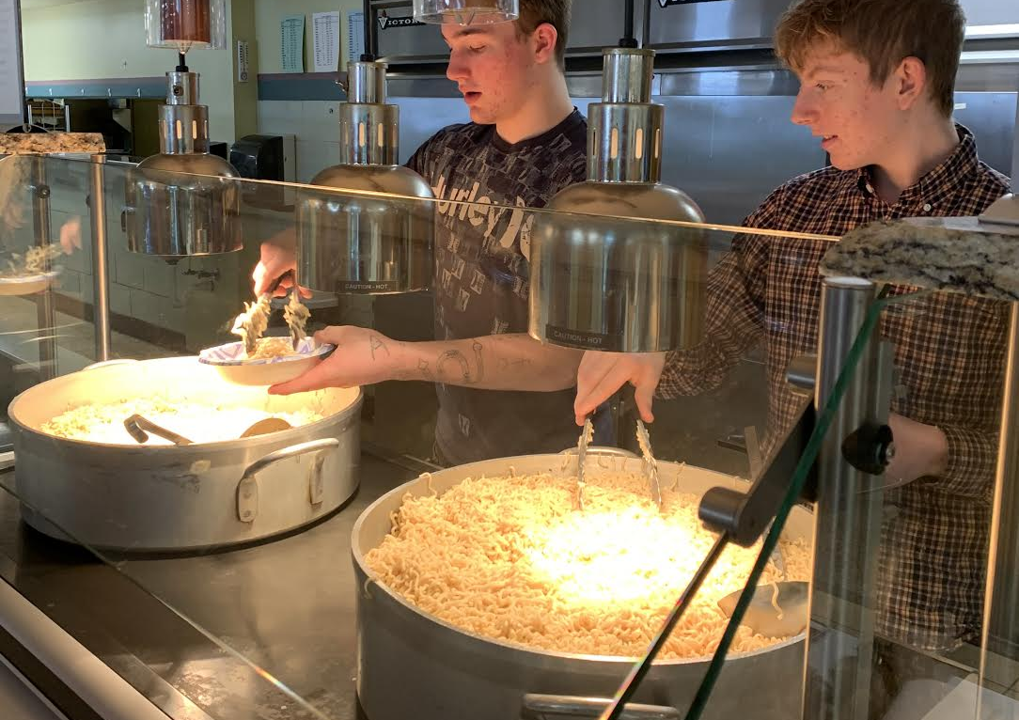
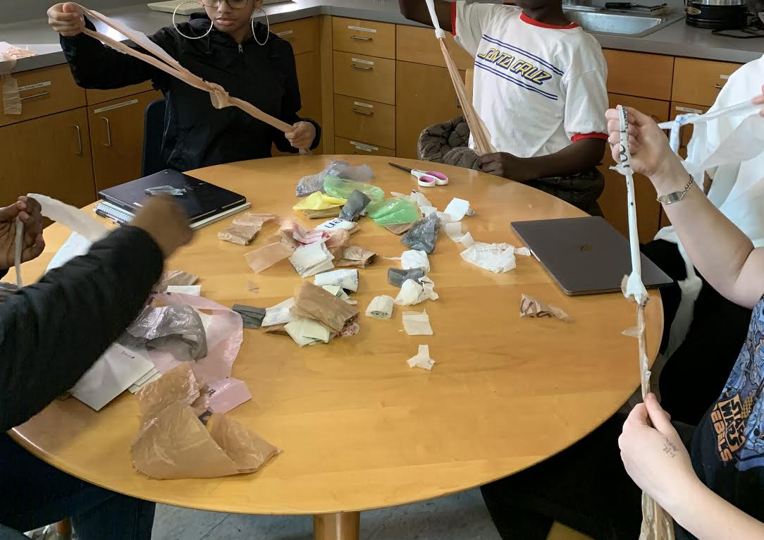
Reaching out to others

Slide 14
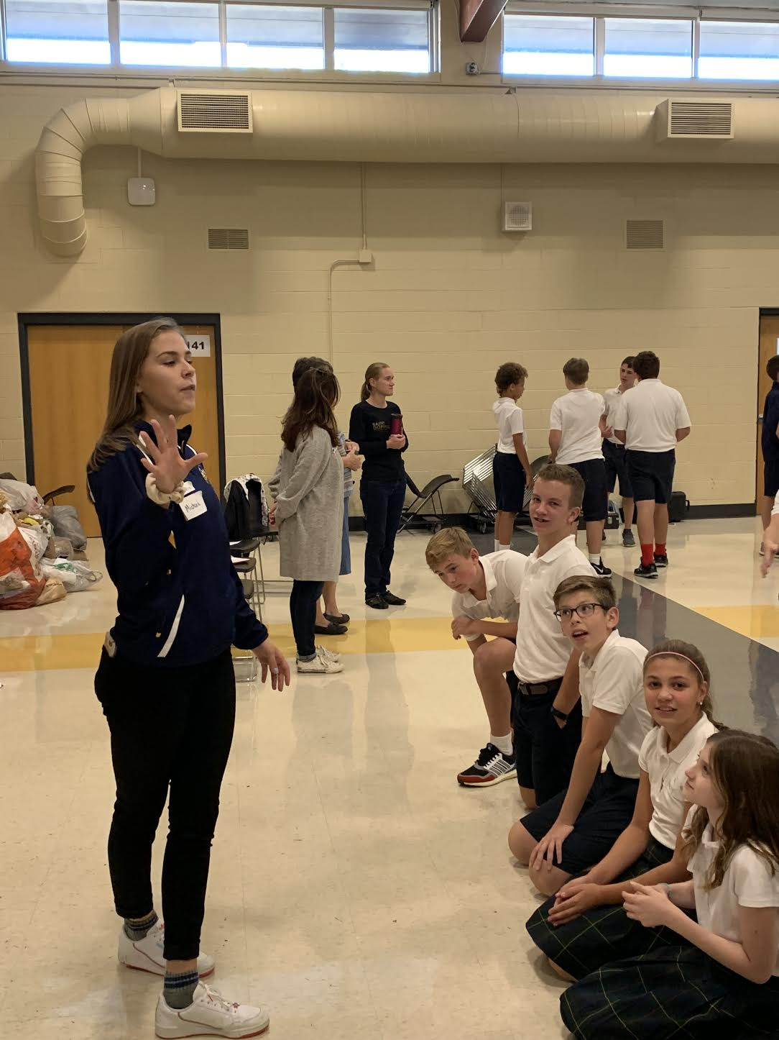
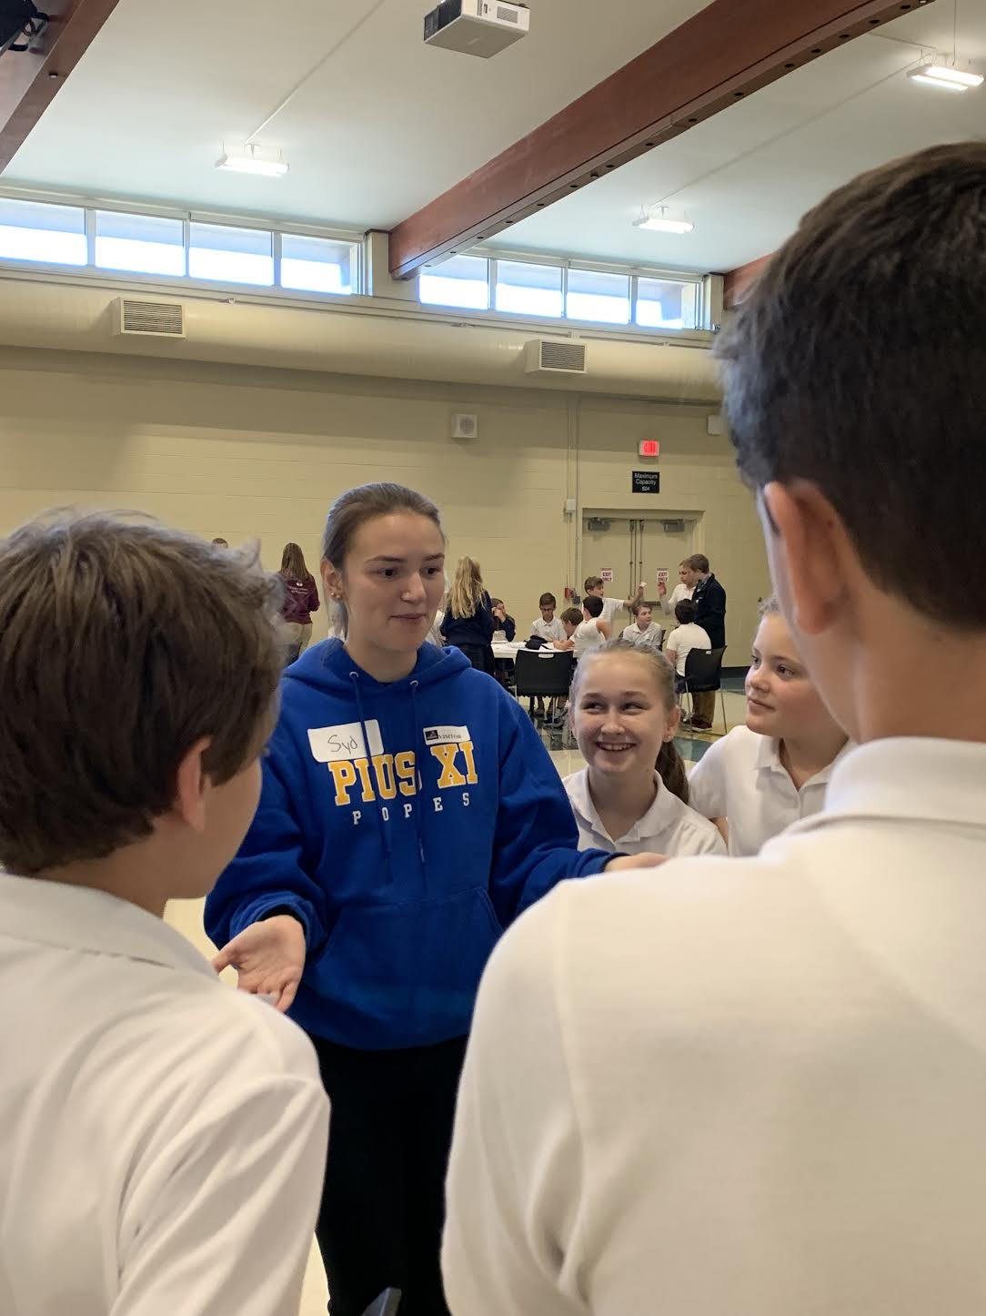
leadership

Slide 15
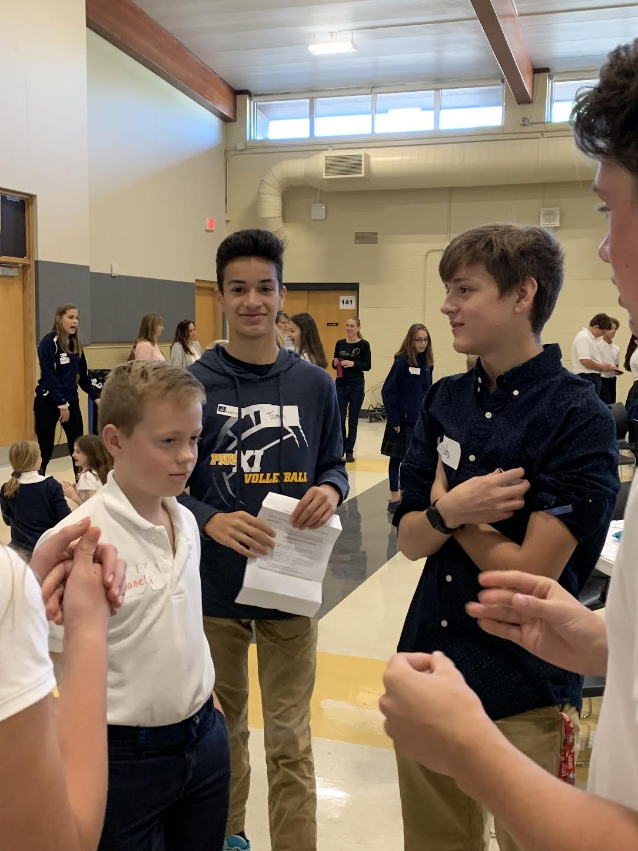
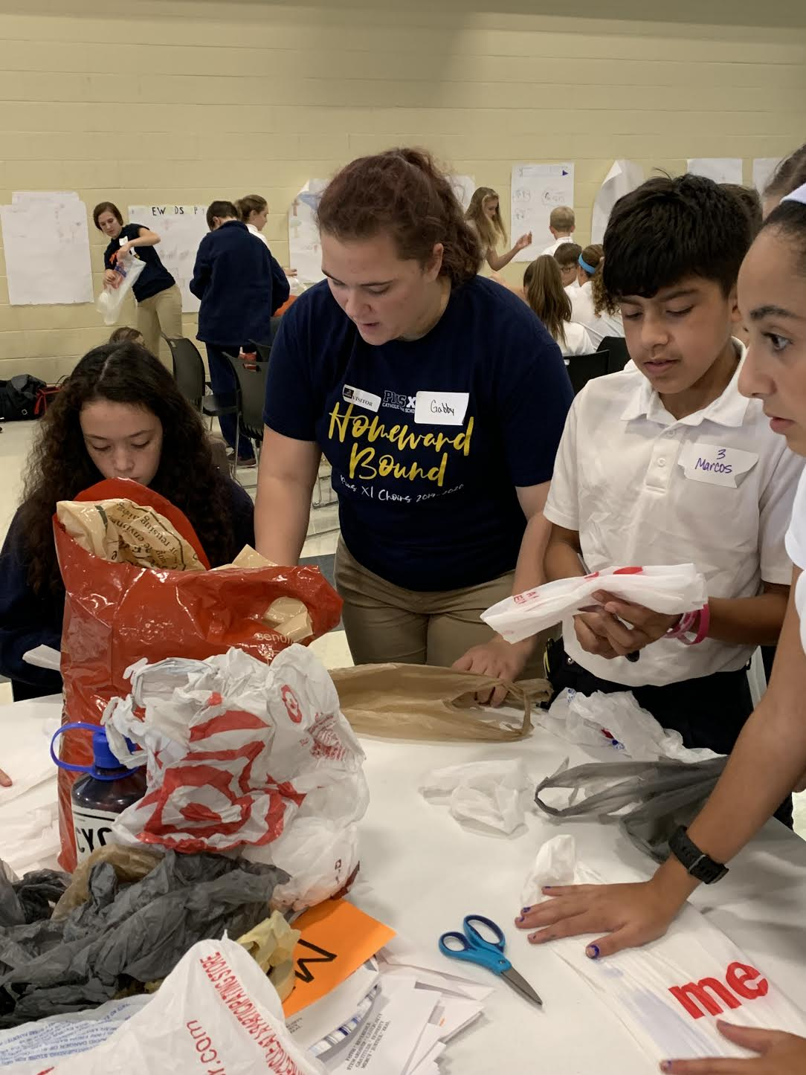

Slide 16
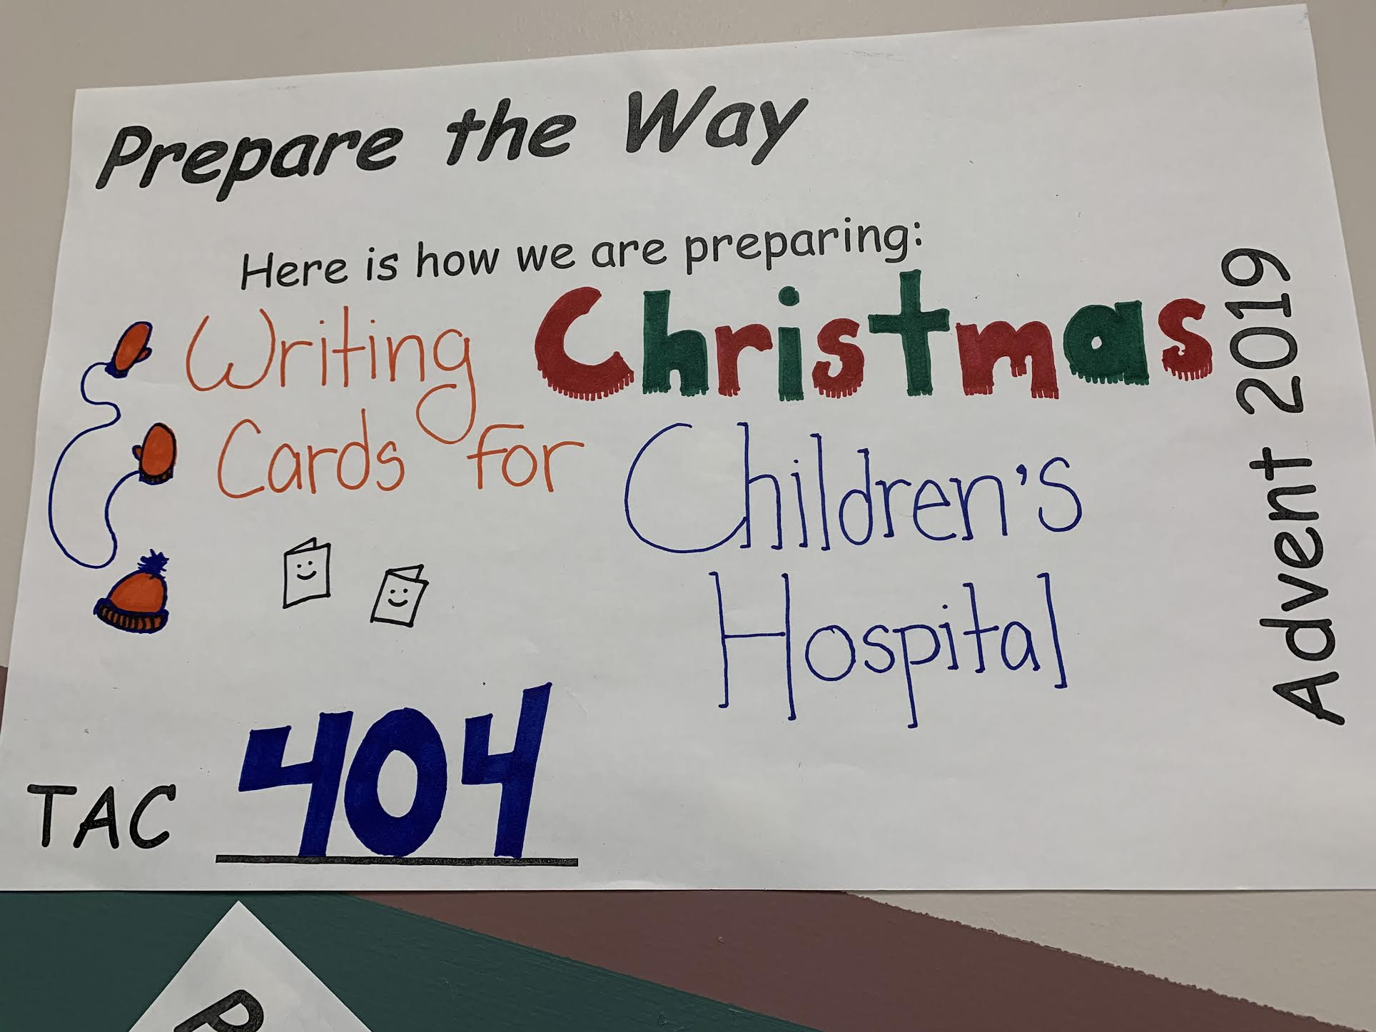
Celebrate!

Slide 17
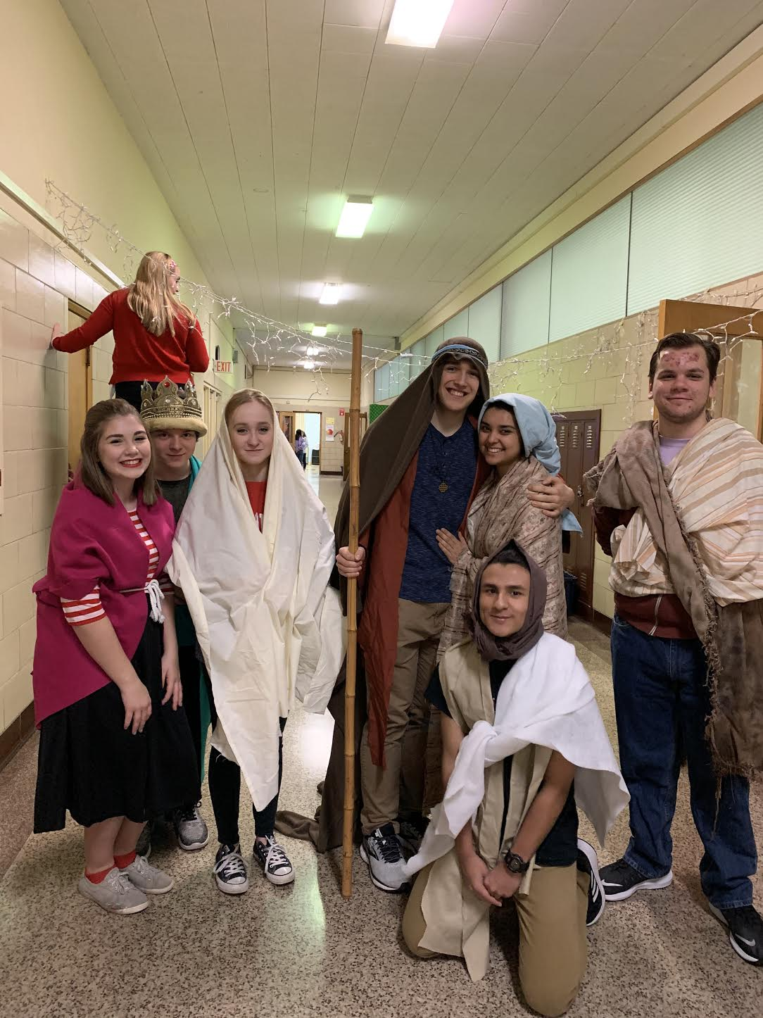
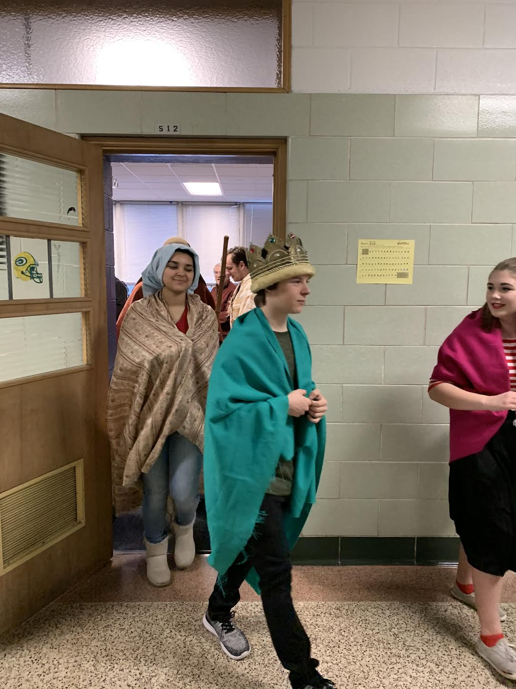

Slide 18
Get involved!

